Slide 1
Understanding Standard Score Conversions
Linear Transformations

Slide 2
John was tested to see if he qualified for placement in special education. Among other
qualifications, John must show a significant discrepancy between estimated scholastic
potential (typically estimated with an intelligence test) and an estimate of academic achievement
in one or more areas of academic skills (e.g. reaching, math, language, etc.).
Tests John Took | John’s Scores | Type of Standard Score | M | SD
Intelligence Test | 125 | Dev. IQ | 100 | 15
Reading Test | 35 | T-score | 50 | 10
Math Test | 550 | CEEB | 500 | 100
Test of Written Language | 50 | NCE | 50 | 21.06*
*I believe I wrote 21.66 in class; it is actually 21.06
Technically, a significant discrepancy is defined as two SD’s.
The question is whether John qualifies, and if so, in what academic areas.

Slide 3
So, what do you do to make this determination?
You convert all the scores to the same metric.
Dev IQ
X DevIQ – M DevIQ
Now, decide which metric you want to use as the common number line.
SD DevIQ
T-score
X t-score – M t-score
I will pick the t-score. It’s easier to think with.
Take each score and convert it to a z-score
SD t-score
CEEB
X CEEB– M CEEB
SD CEEB
NCE
X NCE – M NCE
SD NCE
You could just leave them as z-scores because they are now on the same number line, but t-scores are easier to think with.

Slide 4
If you want to change them all to t-scores, great! But, you obviously don’t have to change the
reading score because it is already a t-score. You just have to convert the other three scores:
the intelligence test score of 125, (2) the math score of 550, and (3) the written language score
of 50. In short, make them all t-scores.
Make John’s Dev. IQ score into a z-score.
Multiply John’s z-score of his intelligence test
onto the SD of a t-score.
The Dev IQ score for John is 125
125– 100
= 1.66
15
1.66 x SD of a t-score
1.66 x 10
= 16.6
This is the z-score of
John’s Dev IQ score.
Add John’s converted SD t-score to the M of a t-score.
Make his Dev. IQ score
into a z-score.
16.6 + 50 = 66.6
66.6 is John’s intelligence test score on the new t-score number line.

Slide 5
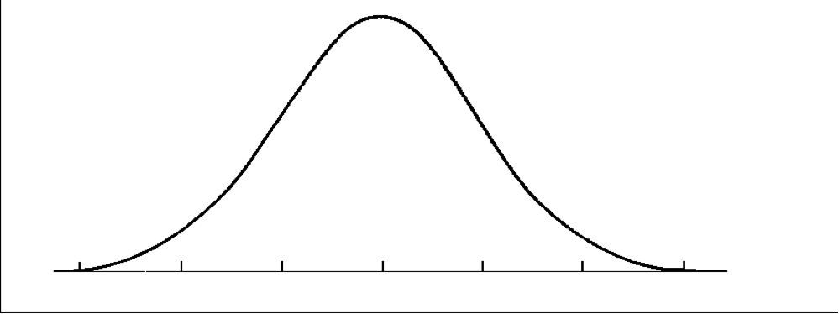
Viola! John’s Dev IQ score of 125 is now a t-score of 66.6.
A Dev. IQ of 125 and a t-score of 66.6
are at exactly the same place on the curve—exactly where they should be.
Deviation IQ score values
100
115
130
T-Score values
50
60
70

Slide 6
The next steps are easy. You do the same thing for each of the other two scores – the CEEB score and the NCE score.
When you are done, you now have all the scores on the same metric (number line).
Now, you have to look and see if there is a significant discrepancy between:
Reading
Yes or No?
Intelligence
Math
Yes or No?
Written Language
Yes or No?

Slide 7
That’s all there is to it.
Kinda cool, huh?
I sure hope it helps. If it does, let me know.

